Slide 1
Anxiety detection on social media text
Ihza Gonzales, Azin Faghihi and Suelem Lee
Notes:
Our project is about detecting anxiety on social media text? How anxious are you right now?

Slide 2
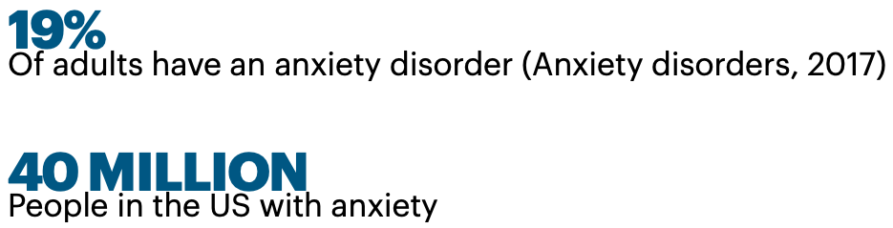
Notes:
About 19% of adults have an anxiety disorder…. To put this in perspective….. that is over 40 million people in the US with anxiety.

Slide 3
4 Ways That Untreated Anxiety Impacts Physical Health
The need to be addressed
Symptoms almost resembles a heart attack
Increased risk of Heart Attack
More Stress hormones
Insomnia and its effects
source
Notes:
In the United States, the most common type of mental disorders is different kinds of anxiety.Panic attack symptoms are so severe that they lead patients to believe they are suffering heart attacks. 2) The actual increased Risk of Heart Attack, Panic attacks and chronic anxiety put a lot of stress on the heart with increased blood pressure and pulse. 3) More Stress Hormones too much adrenaline or cortisol over a long period of time can cause, cognitive decline, Increased risk for other mental illnesses, Higher cholesterol 4) Insomnia can lead to Weakened immune system, Unwanted weight gain...etc
While medications can treat many of these problems, we see the importance of preventive medicine at this point

Slide 4
But also because:
Help avoid Sleepless nights
Missed opportunities
Avoid getting sick
Make you feel like your full self.
Notes:
And specially not be only on extreme measures, we should address anxiety also because it can help avoiding Sleepless nights, missed opportunities, avoid feeling sick, and keep you feeling like your full self.

Slide 5
Anxiety that interferes with:
day-to-day functioning
affects work
school
social life
source
Notes:
So how do we know when to seek treatment? Anxiety that interferes with day-to-day functioning or affects work, school, or social life,...already has the need to be addressed. This interruption in daily routine is often the point at which treatment interventions are needed according to psychCentral

Slide 6
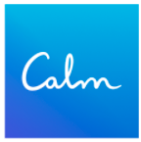


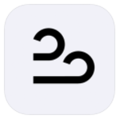

Available apps today:
Best anxiety apps
Notes:
These are the top apps today tackling the anxiety issue. Calm is currently the most popular, one focused on sleep, meditation and relaxation. One interesting thing was a mood check in feature. That was cool and worth to check out. Dare is more focused on facing your fears to deal with anxiety, panic, worry or insomnia, mostly with relaxing audio recordings. Shine is focused on anxiety experienced in different cultural backgrounds, with guided meditation, community forums and podcasts. Breathwrk, helps you with breathing exercises. Hypnosis, seems interesting, uses mostly audio recordings focused on relieve of stress, anxiety and PTSD. There are numerous ways of addressing this issue, mostly they are addressing people who are already aware of their anxiety need, and the case is that most of the time, we become aware when it’s too late, when you are already experiencing symptoms.

Slide 7
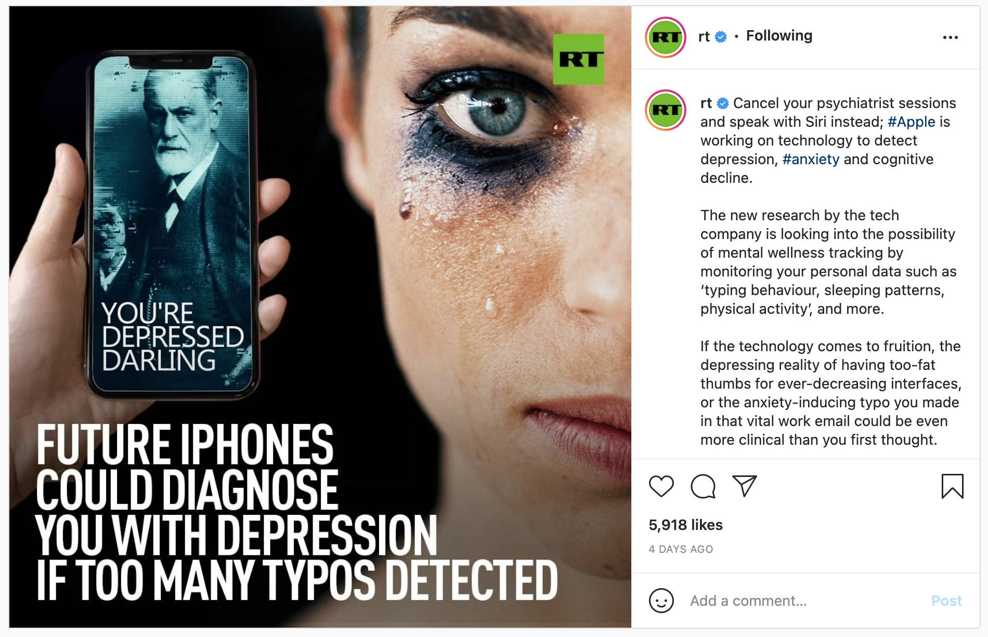
Notes:
This is an example of how some apps are already creating for the purpose of analyzing text to provide feedback, in this case detecting depression through typos. Now one’s choice of words even punctuation can hint at the mental or emotional status of a person.

Slide 8
Problem statement
From anxiety subreddit can we classify them into varying degrees of anxiety and provide tailored messages to address anxiety with a Chatbot response system?
Notes:
Which leads us to our presentation, targeted for future potential investors with semi-technical knowledge. Our problem statement is From anxiety subreddit can we classify them into varying degrees of anxiety and provide tailored messages to address anxiety with a Chatbot response system?

Slide 9
Methodology
EDA
Modeling for anxiety Classification
Sentiment analysis to further classify severity of anxiety
Chatbot for immediate response
Notes:
Our methodology starts with EDA, modeling for anxiety Classification, Sentiment analysis to further classify severity of anxiety, Chatbot for immediate action in case of severe and moderate anxiety.

Slide 10
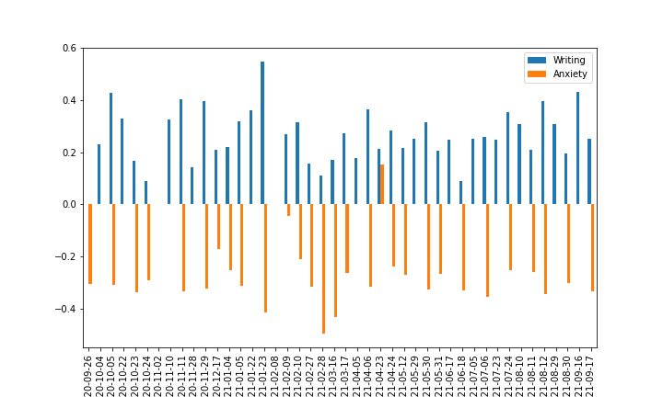
Data:
Posts evaluated from anxiety vs writing as a neutral sentiment subreddit:
Raw data:
Notes:
Posts evaluated from anxiety and writing (as a neutral sentiment) subreddit: It’s clear how writing has a predominant positive sentiment

Slide 11
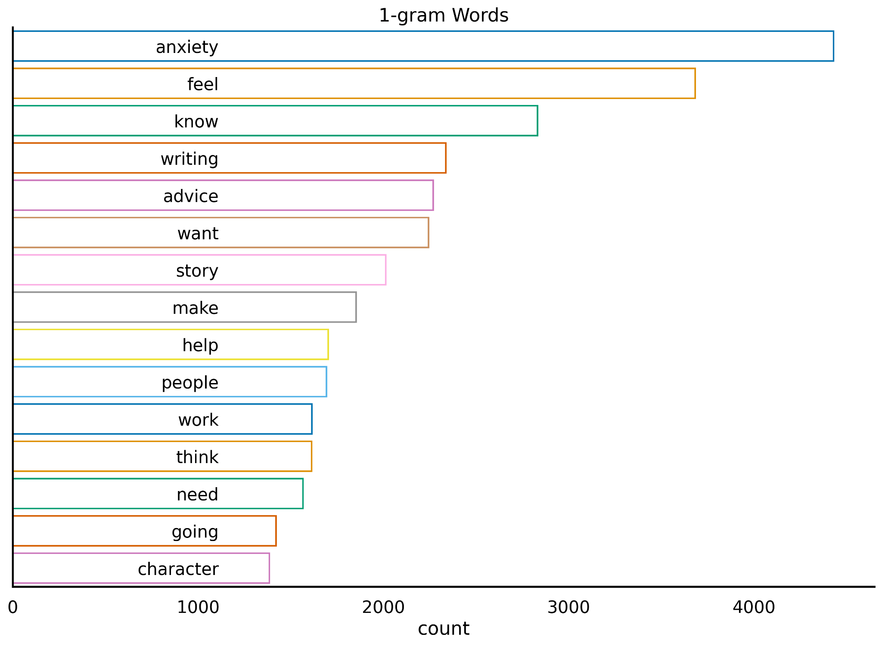
Word Count
Notes:
The reason why we kept in the word “anxiety” is that if someone was to type in “I have anxiety”. It will not categorize it as anxiety. Words like feel, anxiety, advice, want, help are very concerning prevalent words.

Slide 12
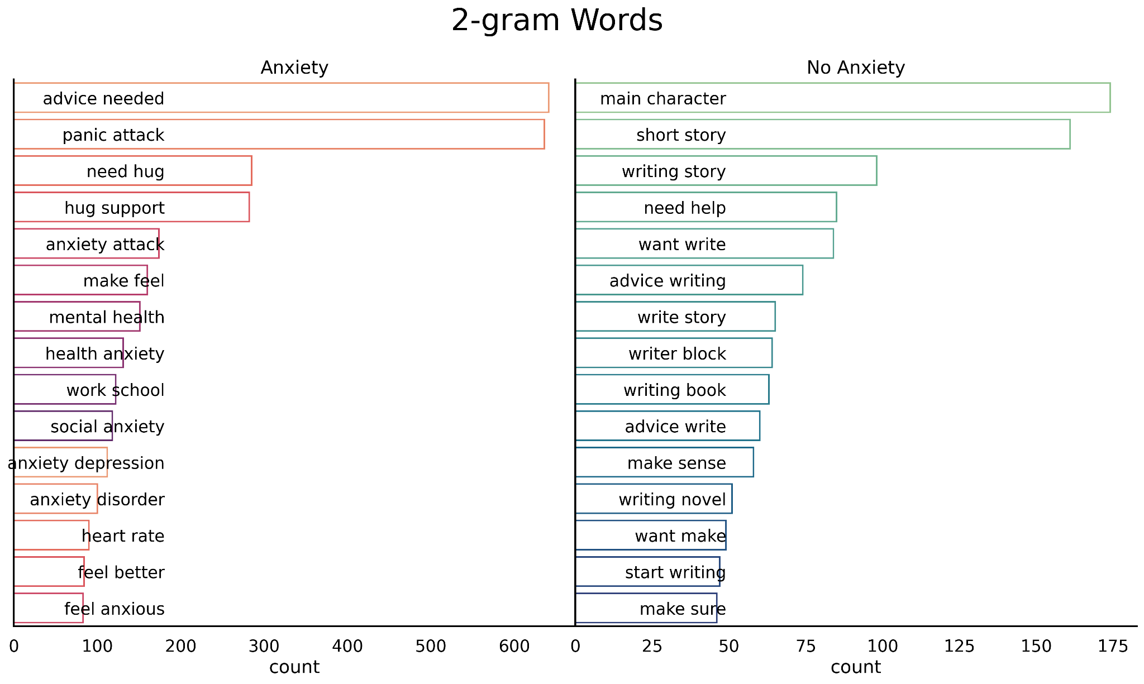
Bigrams
Notes:
Advice needed, panic attack, need hug, heart rate, …are clear words indicating requests for help, motivation and support.
Bigrams such as heart rate indicating physical symptoms, work school are even indication of locality which can also be addresses with geolocations.

Slide 13
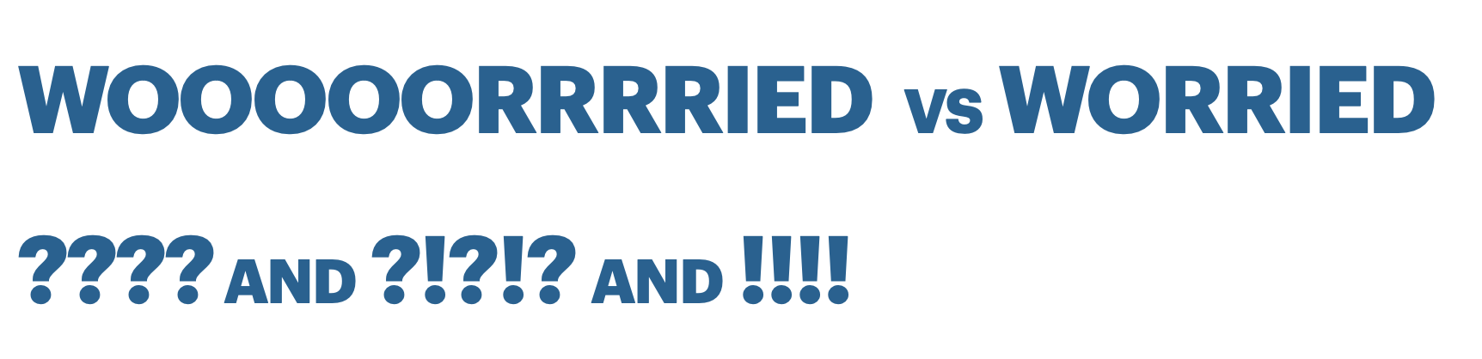

Adjusted term weights on vader sentiment analysis:
Notes:
We take a next stop here by adjusting term weights were 1. Repeated consecutive letters, 2. Frequency of Punctuation use, and use of emoticons

Slide 14
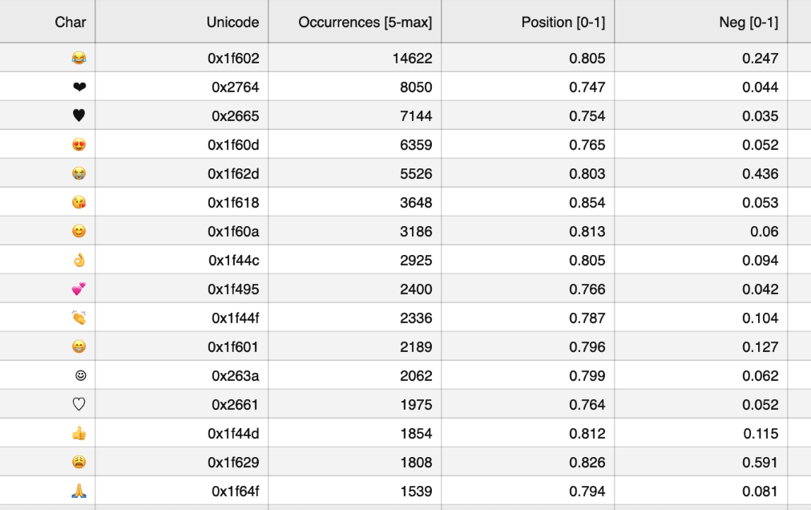
Emojis: Sentiment Scores

Slide 15
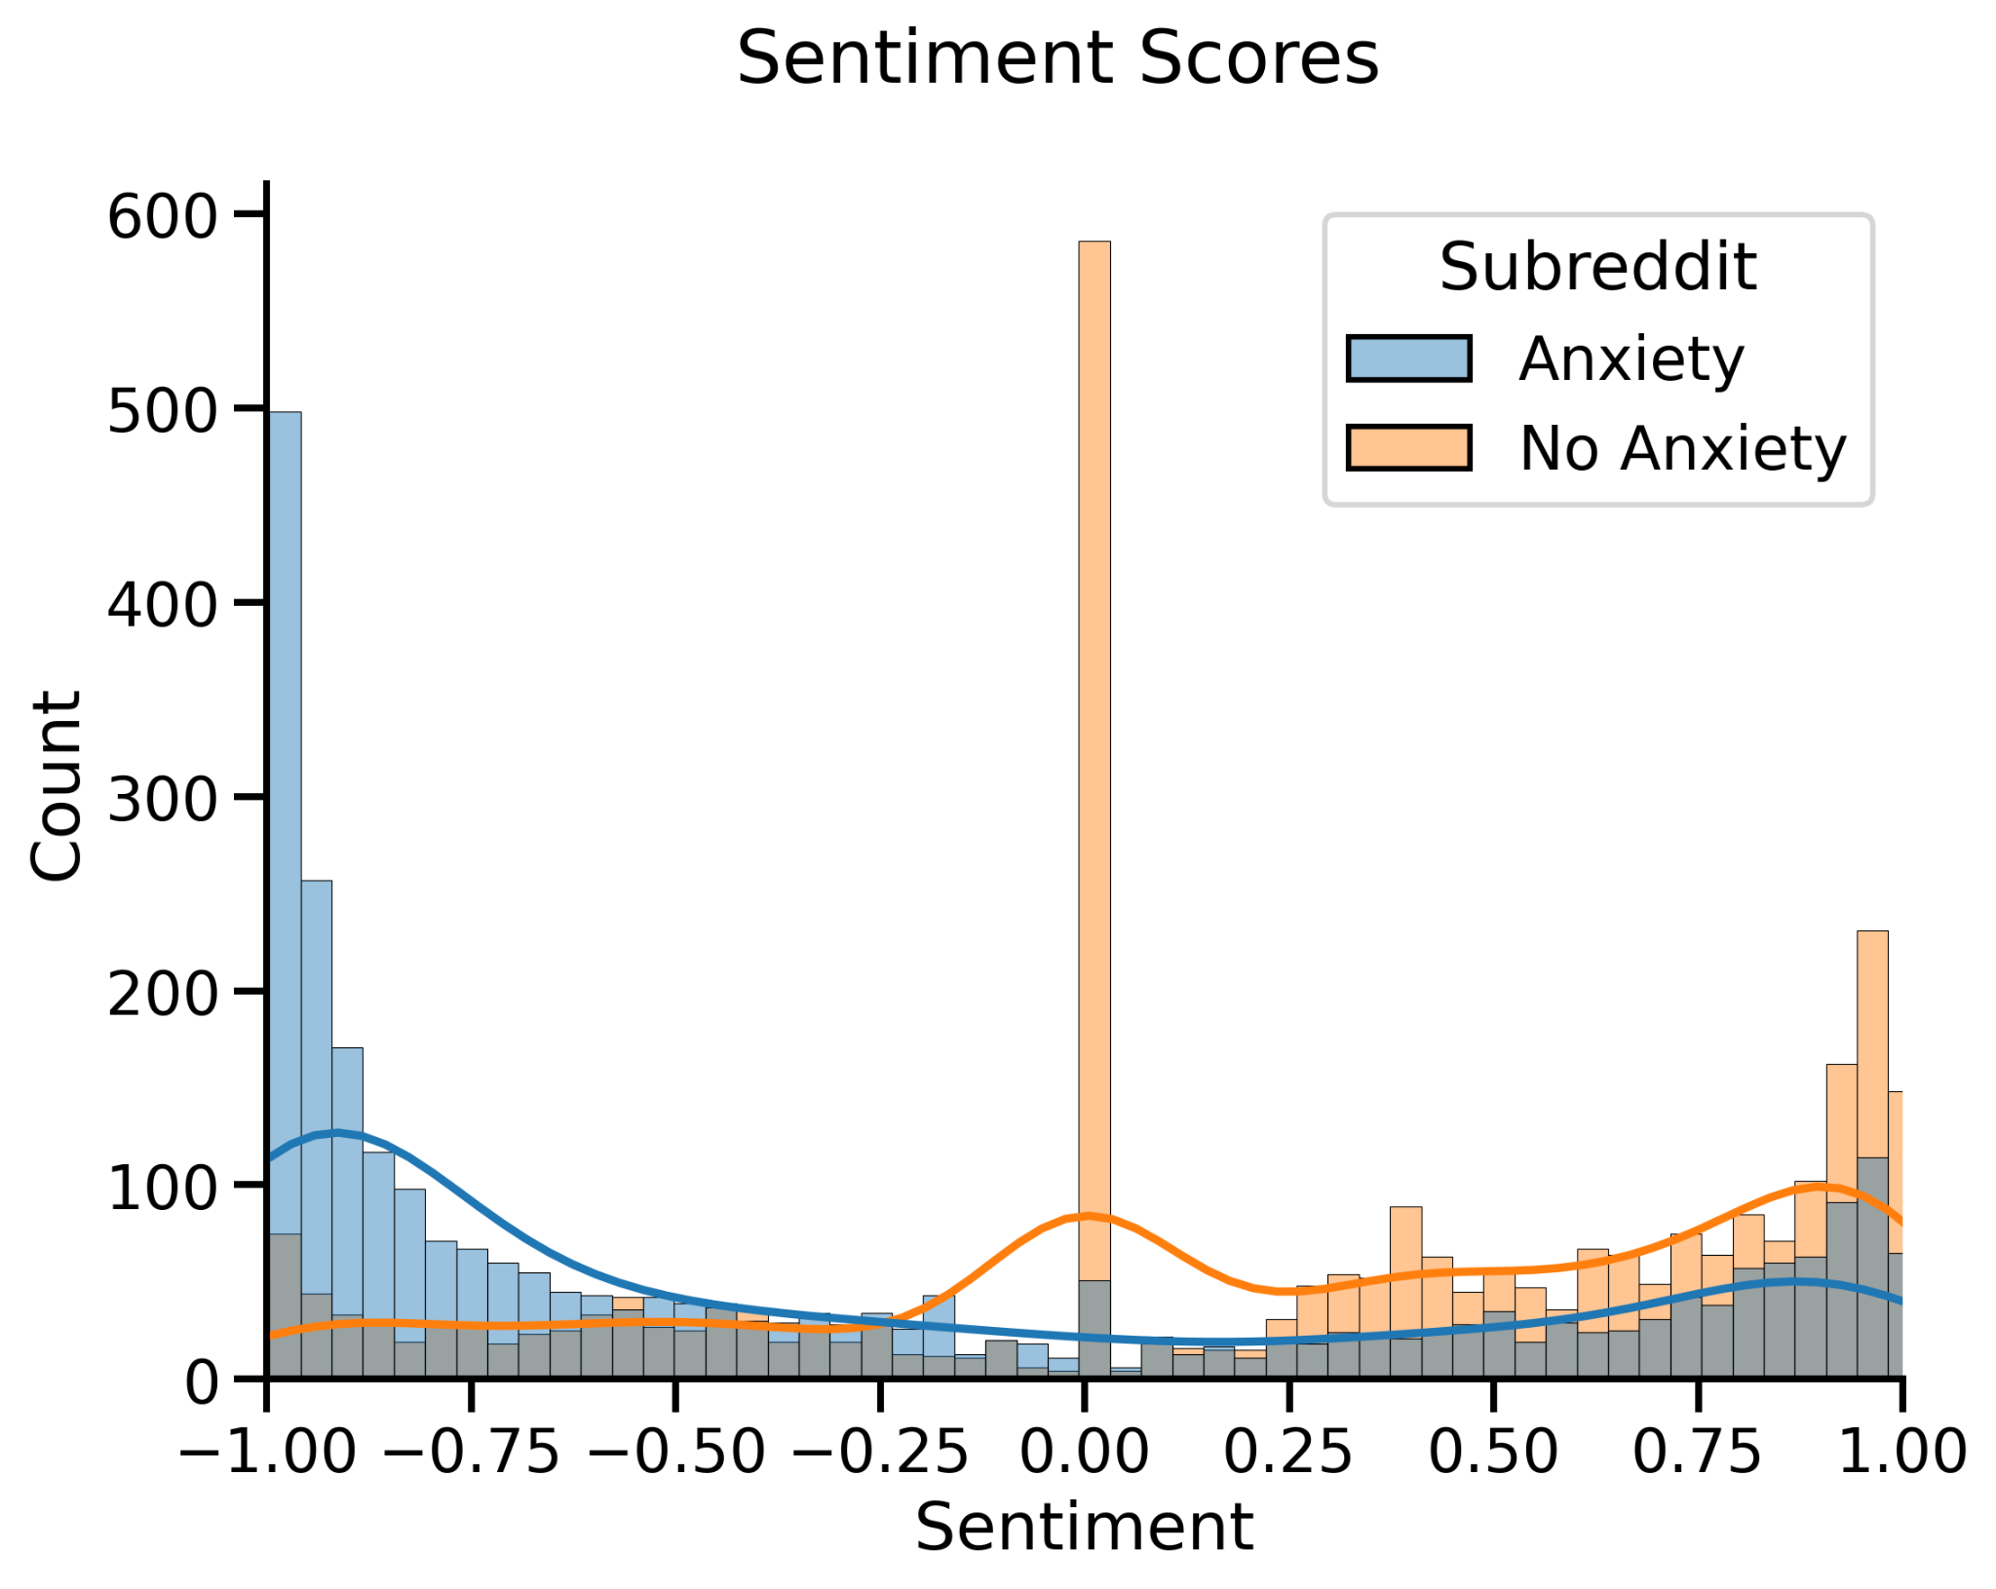
Overall Sentiment Scores
Notes:
With the intentions of visualizing negative sentiment on anxiety posts to train our models, this is a clear visual.

Slide 16
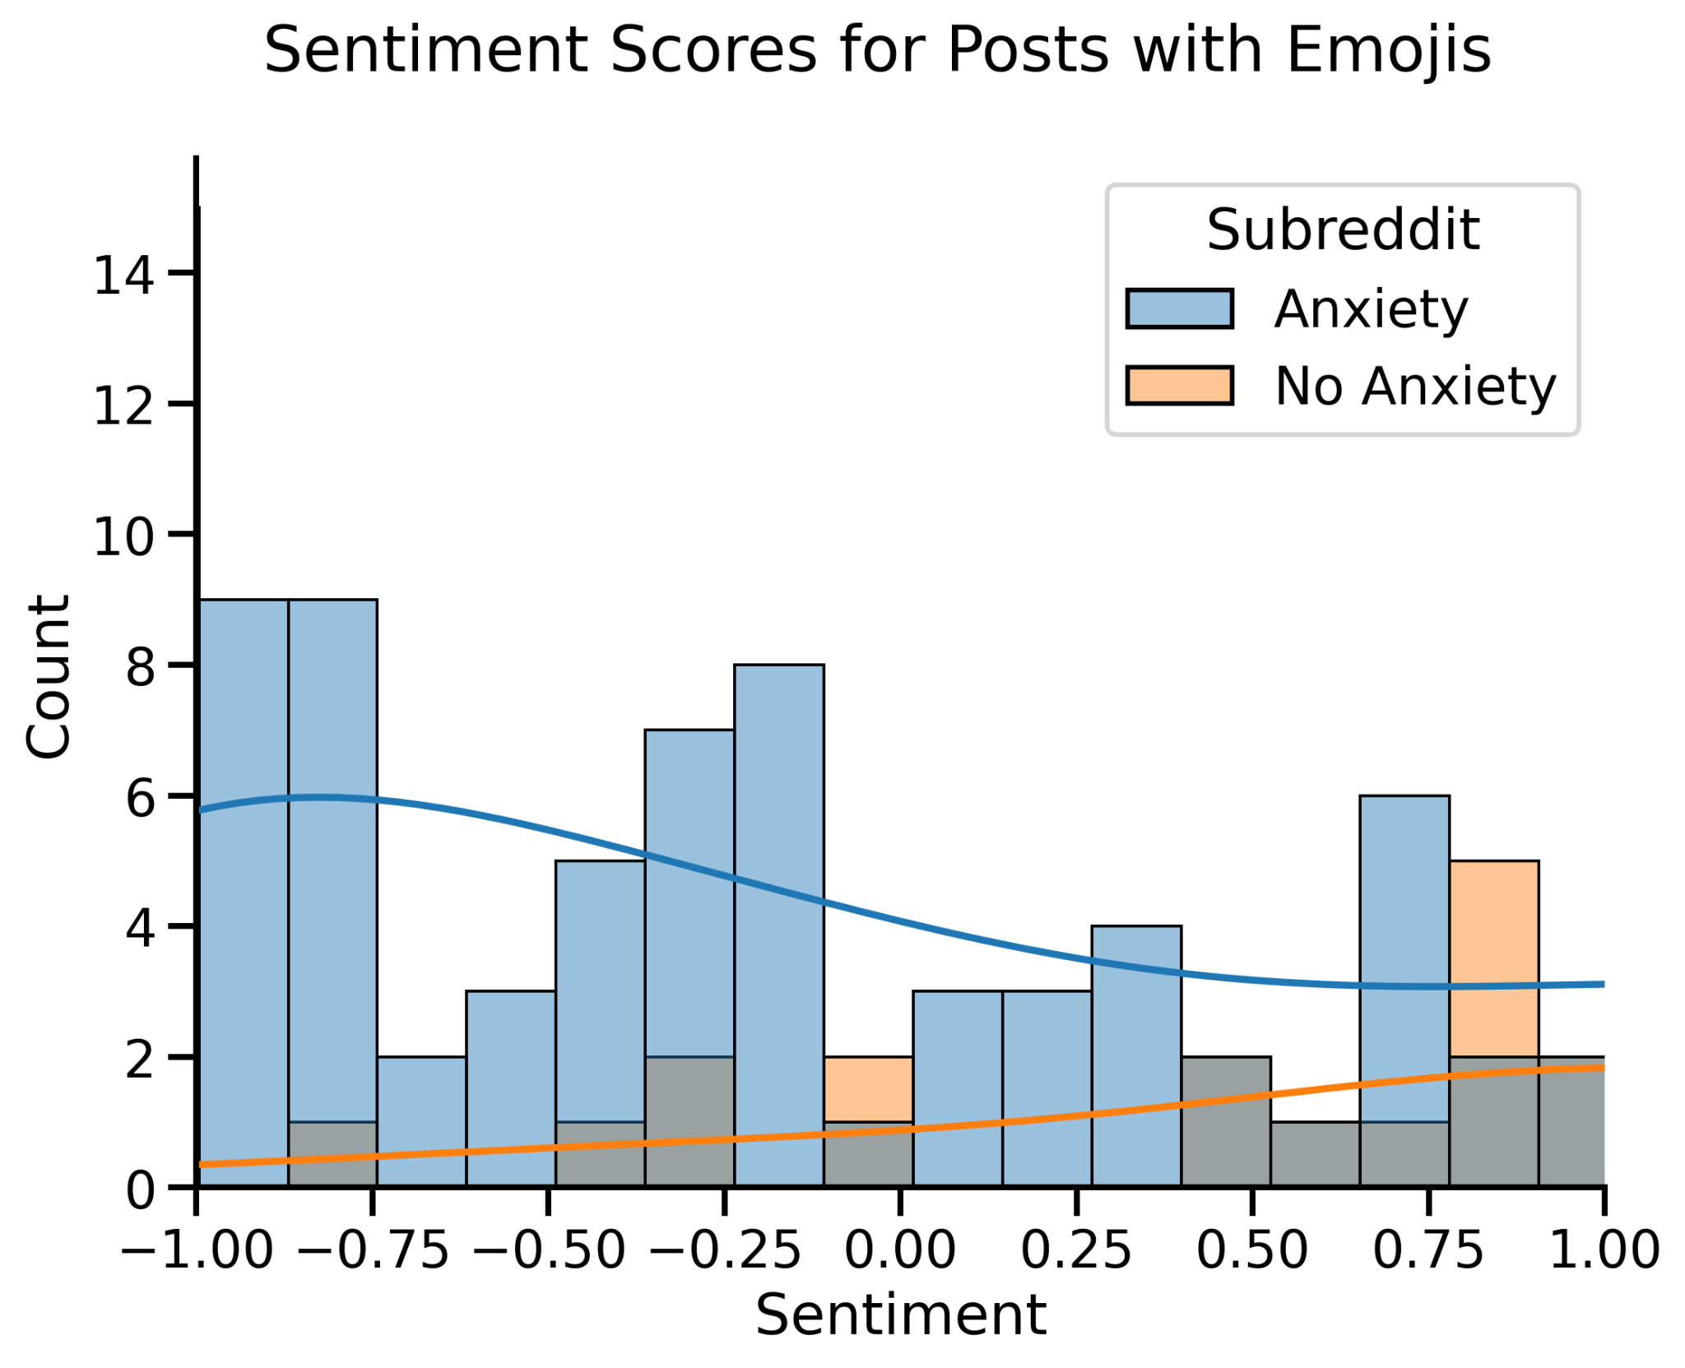
Emoji Usage
Notes:
With the intentions of visualizing negative sentiment on anxiety posts to train our models, this is a clear visual.

Slide 17
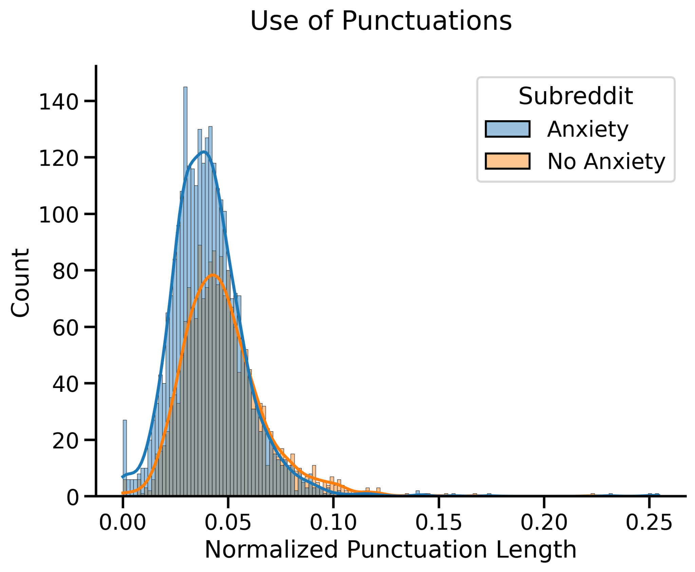
Punctuation Usage
Notes:
M

Slide 18
Modeling

Slide 19
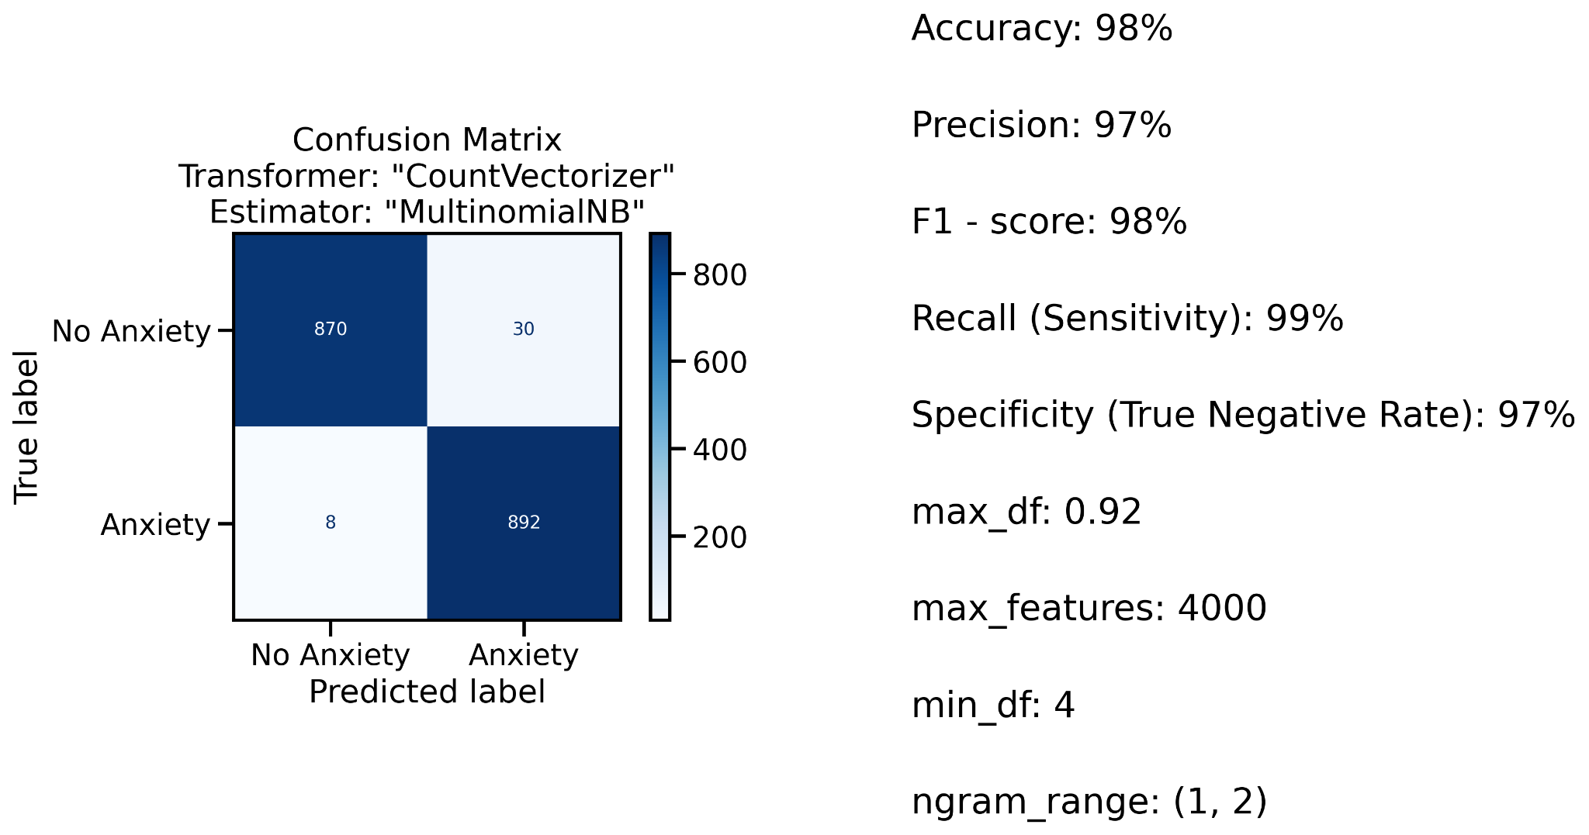
Multinomial Naive Bayes

Slide 20
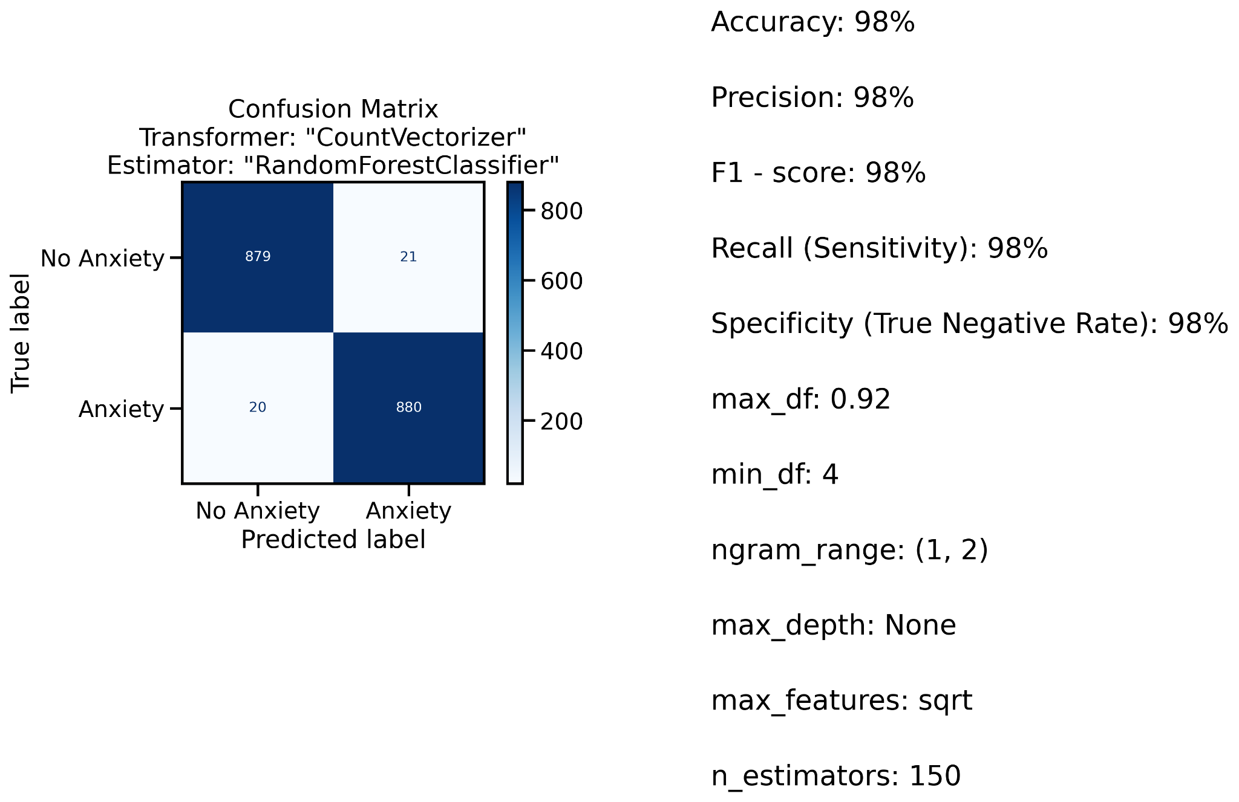
Random Forest

Slide 21
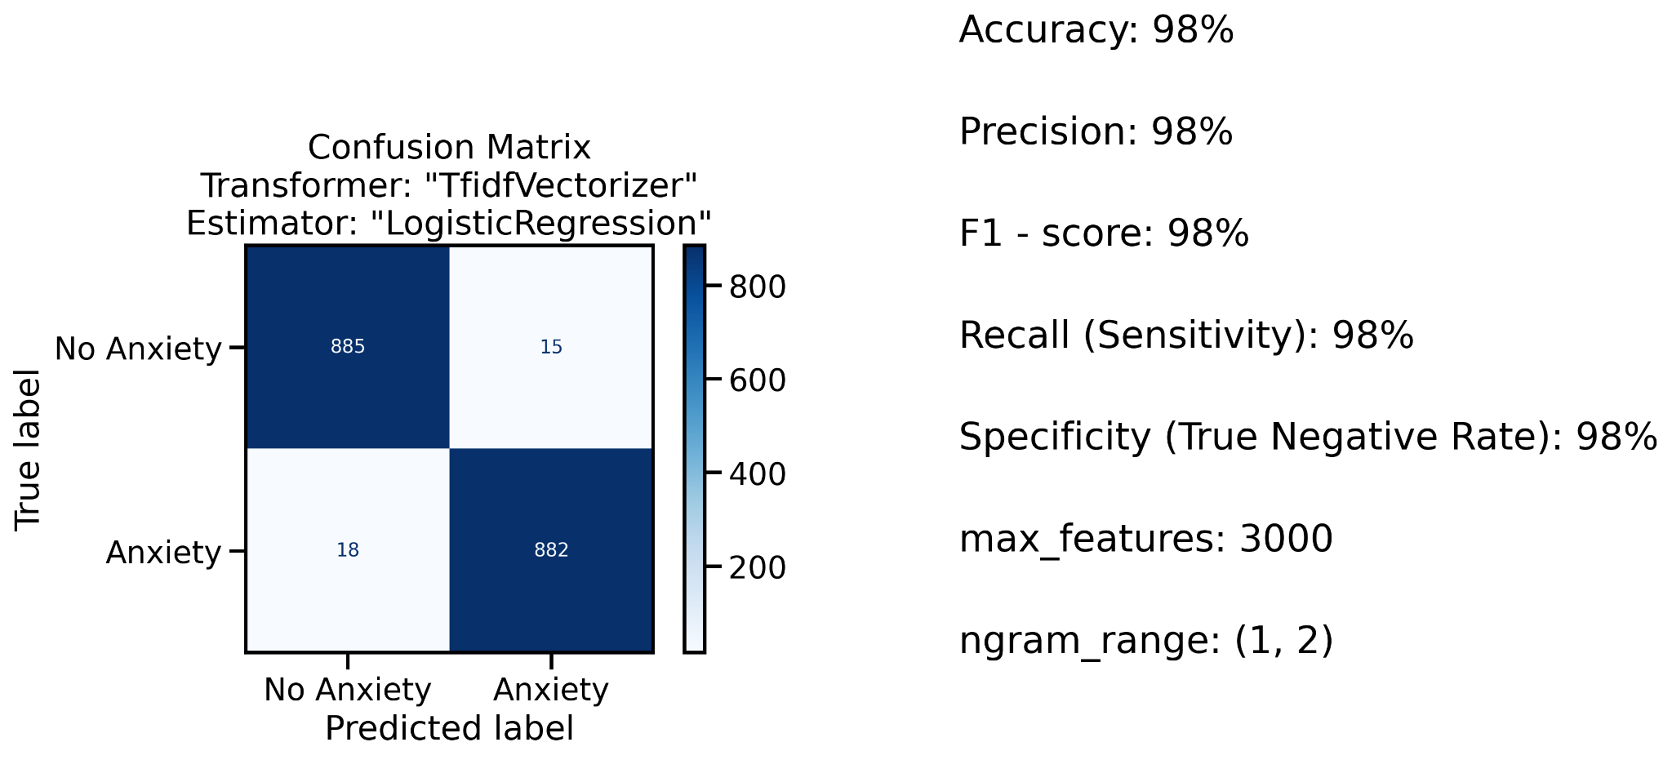
Logistic Regression

Slide 22
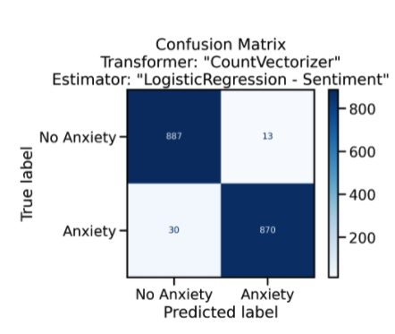
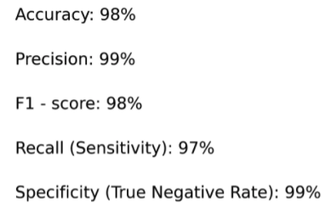
Logistic Regression - with Sentiment Scores

Slide 23
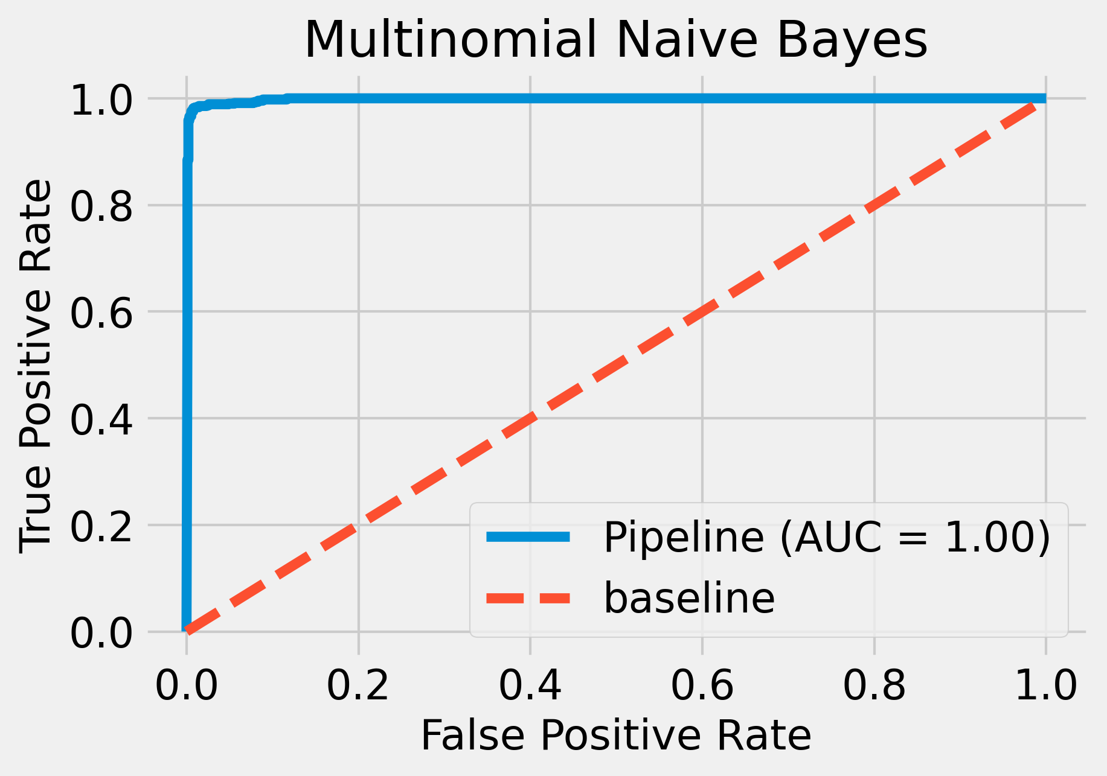
ROC Curve

Slide 24
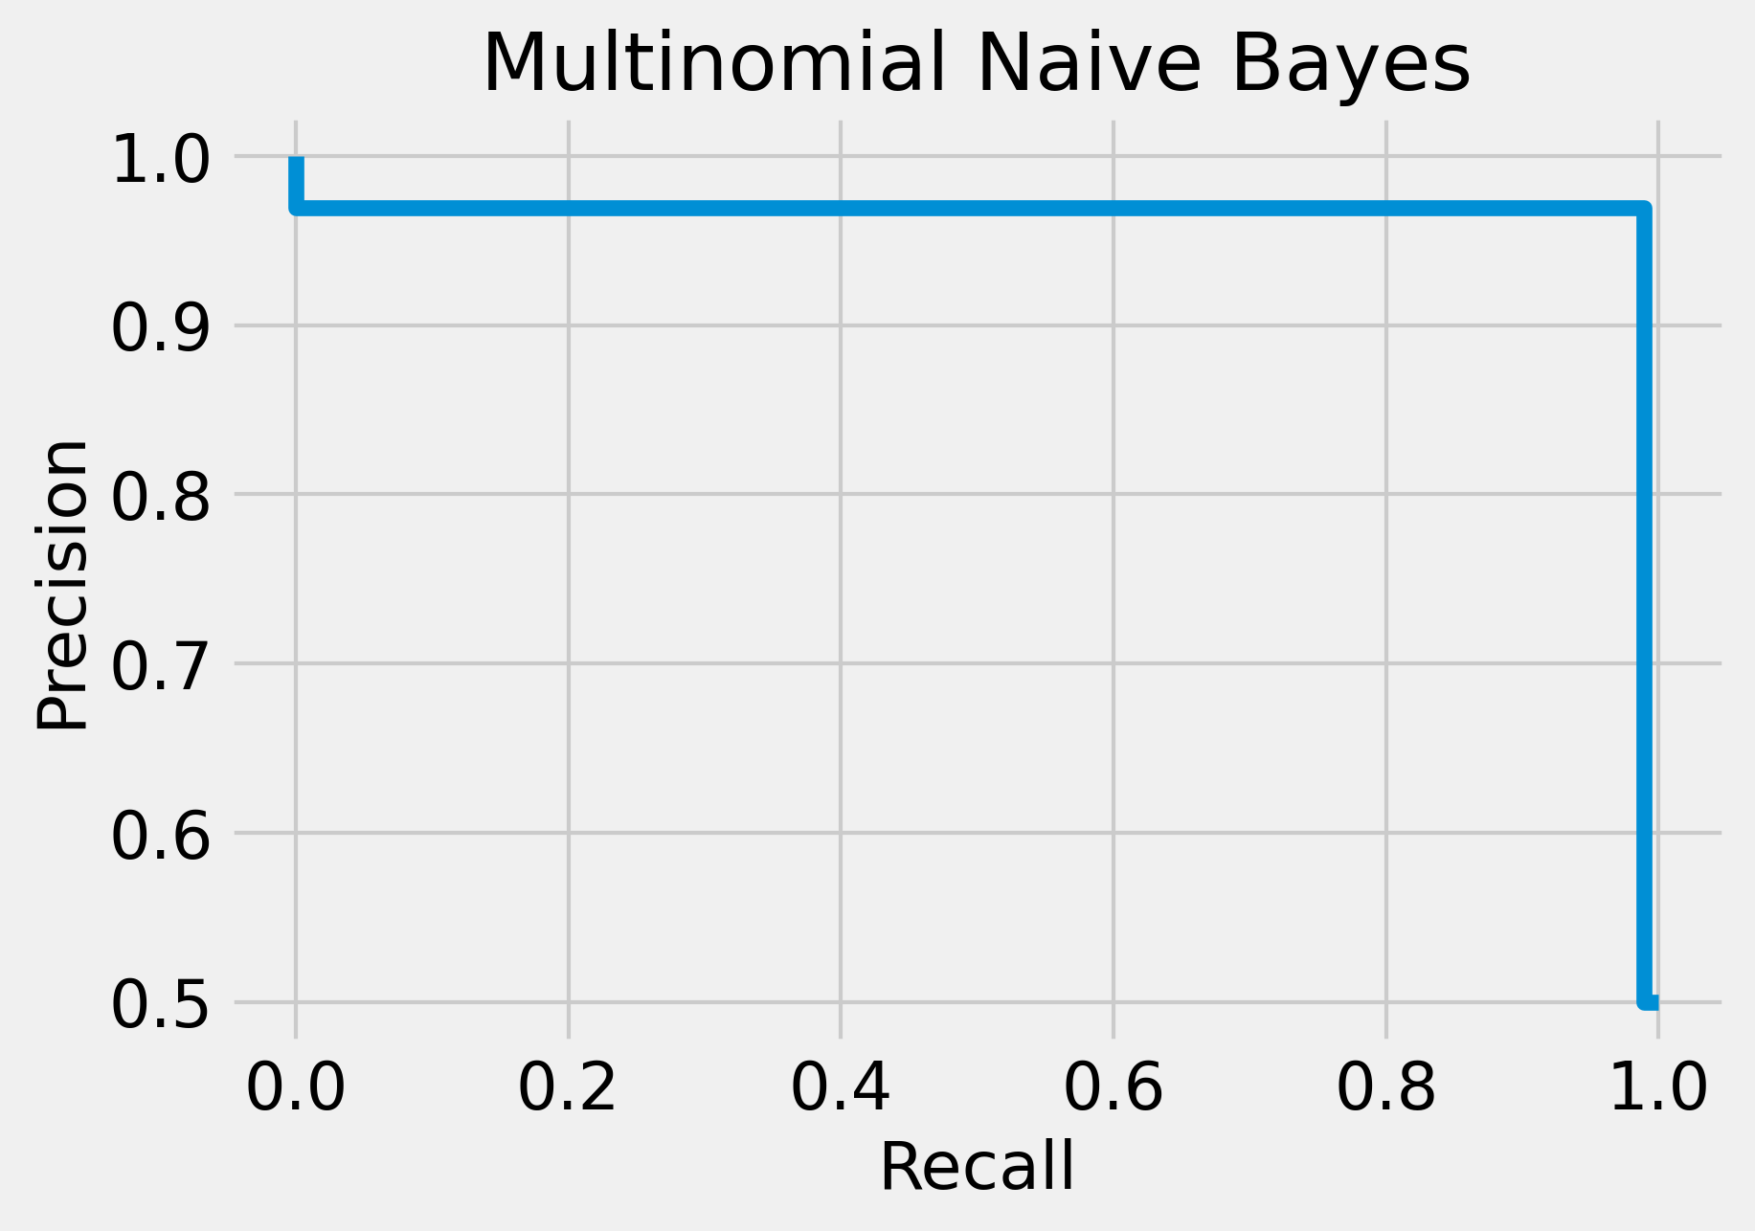
Recall-Precision Curve

Slide 25
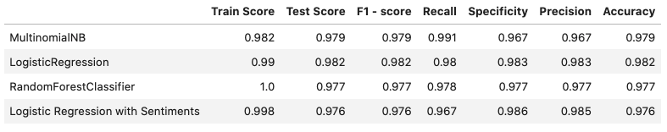
Modeling Results

Slide 26
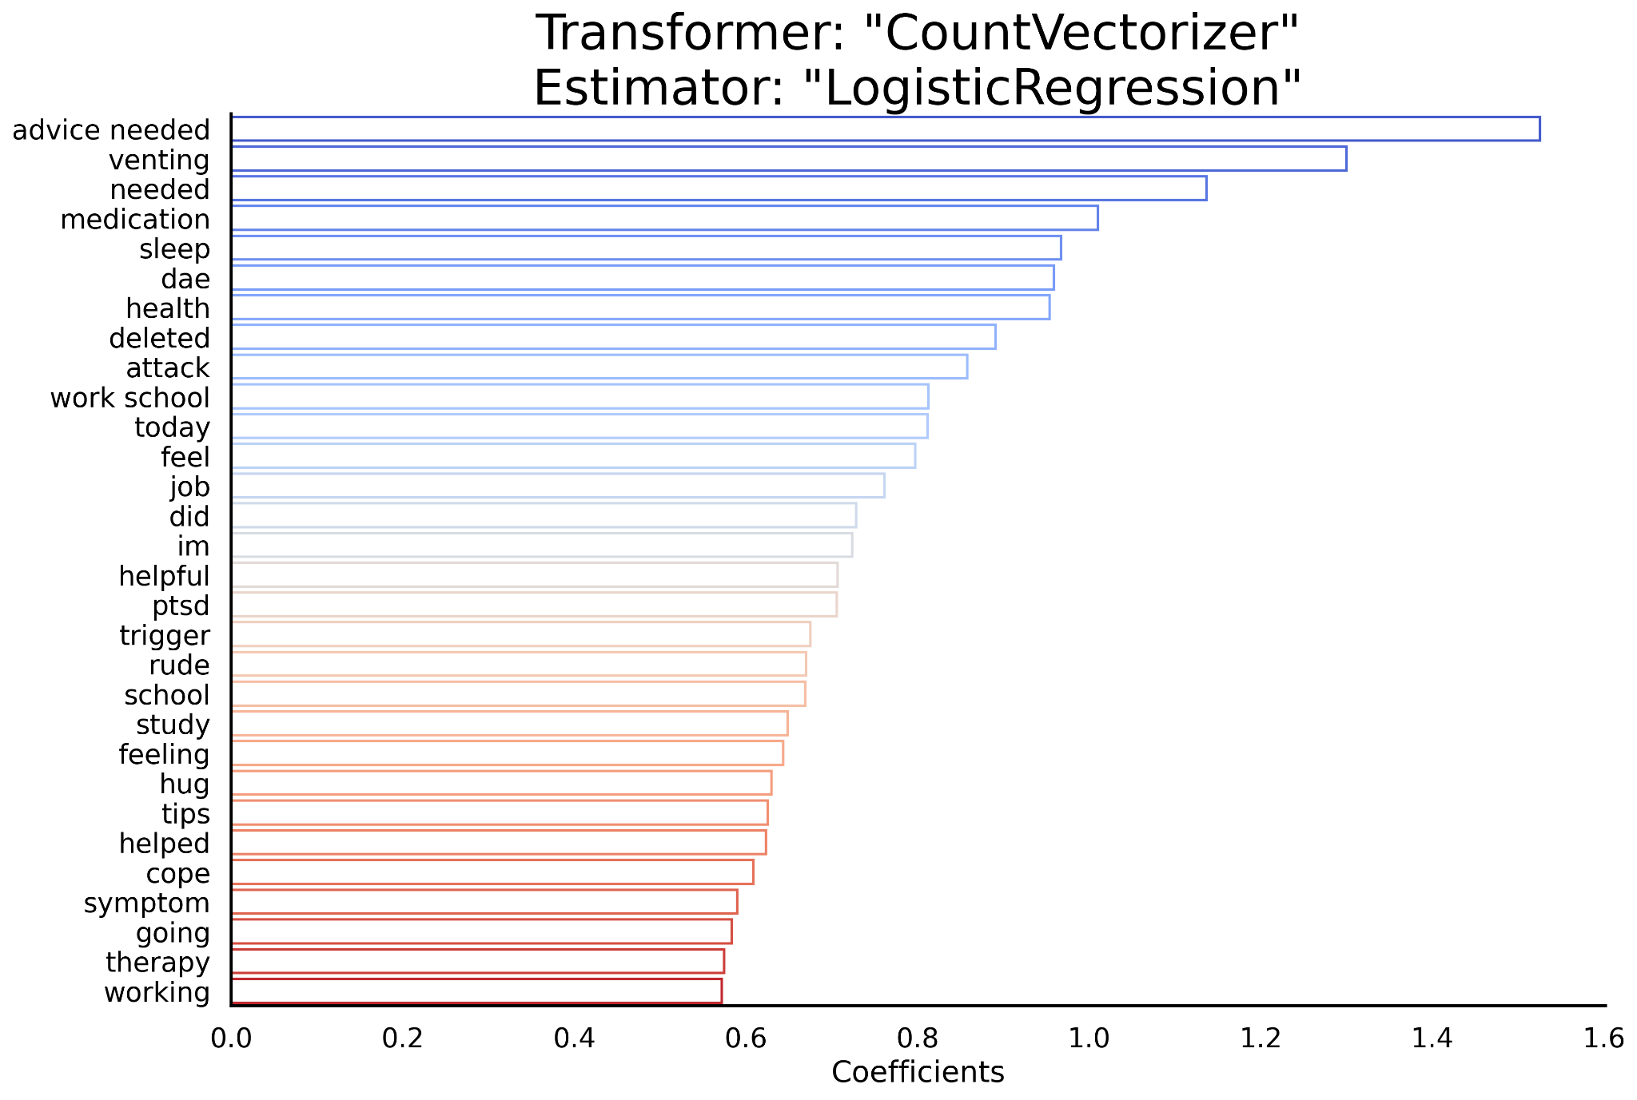
Coefficients
Notes:
Ihza:

Slide 27
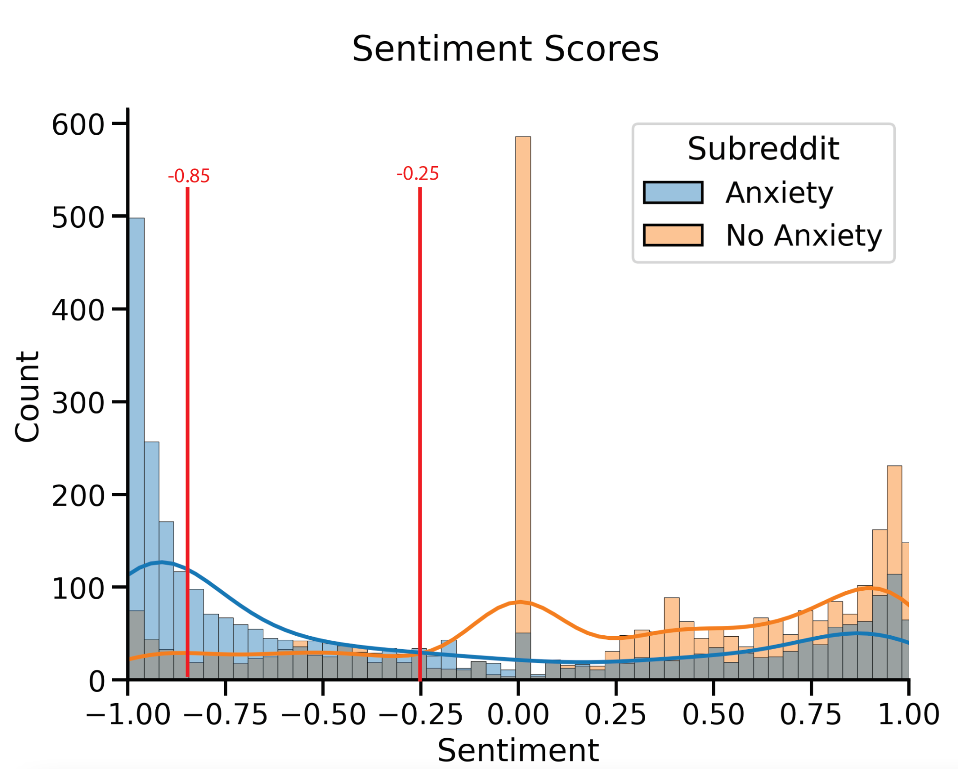
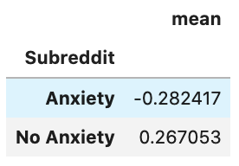
Classifying users messaging anxiety levels:
Threshold for severity of Anxiety
Notes:
Threshold for severity of anxiety, drawn at -0.85 for severe anxiety and -0.25 for Moderate anxiety.

Slide 28
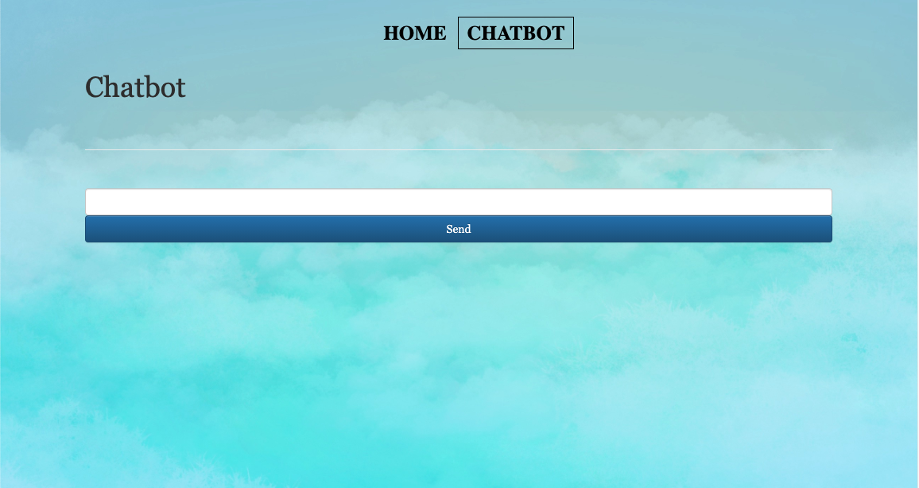
Chatbot

Slide 29
Anxiety disorder Prevention
Take care of your body by eating a well-balanced diet
Limit alcohol, caffeine, and sugar consumption.
Take time out for yourself every day.
Trim a hectic schedule to its most essential items.
Keep an anxiety journal. Rank your anxiety on a 1-to-10 scale. Noting the events during which you felt anxious and the thoughts going through your mind before and during the anxiety. Keep track of things that make you more anxious or less anxious.
Notes:
Everybody knows how to self treat from anxiety, or google it, you need a well-balanced diet, take care of our body. Limit your alcohol, caffeine, and sugar consumption.Take time out for yourself every day. Trim a hectic schedule to its most essential items. Keep an anxiety journal is quite important. Rank your anxiety on a 1-to-10 scale. Keeping track of things, when it makes you anxious or less anxious.

Slide 30
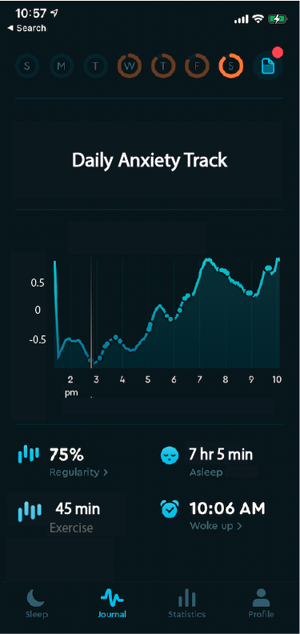
Prototype UI
Notes:
That is why we see this project taking it forward, it is just an illustration of the potentiality of this app taken into care of tracking your anxiety texts and overall monitoring of your mental health and keep you on track.

Slide 31
Next Steps
Analyse expressions such as sarcasm.
Further analyse events, perceptions or experiences that can cause anxiety or expressed on texts.
Physically classify anxiety levels through cellphone cameras and touchscreens, detecting bodily responses, like sweat, heart rate, flushed skin tone, tremblings and breathings.
Further analyse long term health related anxiety or short-term anxiety.
Identify trends and maybe even predict future occurrences, of panic attack or anxiety break.
Notes:
Our next steps are to
Be able to Analyse expressions such as sarcasm.
Further analyse events, perceptions or experiences that can cause anxiety or expressed on texts.
Physically classify anxiety levels through cellphone cameras and touchscreens, detecting bodily responses, like sweat, heart rate, flushed skin tone, tremblings and breathings.
Further analyse long term health related anxiety or short-term anxiety.
Identify trends and maybe even predict future occurrences, of panic attack or anxiety break.

Slide 32
Soooo…
do you think you have anxiety?

Slide 33
Thank you for listening,
Any questions?

